Slide 1

AMCAT dataset EDA

Slide 2
About me
Hello there! I’m Suneel_IN1241045, a data science enthusiast currently working as an intern at Innomatics Research Labs.
Background: I hold an M.Tech degree and am driven by a passion to apply my analytical skills in the dynamic field of Data Science.
Why Data Science: I'm attracted to Data Science for its power to solve complex problems and drive innovation through data-driven insights.
Work Experience: No direct experience in Data Science yet, but eager to apply my strong analytical background in a practical setting.
LinkedIn & GitHub Profiles:
- GitHub: [https://github.com/MohanSuneel]
- LinkedIn: [https://www.linkedin.com/in/mohansuneel/]

Slide 3
Problem Statement
The AMEO dataset comprises anonymized biological data, skill scores, and employment outcomes. The challenge is to explore the relationship between salaries and other features to determine which factors most significantly influence salary levels. Through this analysis, the goal is to uncover insights into the determinants of salary variation..

Slide 4
Brief About Data
The AMEO dataset provides a detailed overview of engineering students, highlighting various aspects of their academic and professional backgrounds. Here's a structured summary based on the provided information:
1. Gender Distribution**: The dataset primarily consists of male engineering students, indicating a gender disparity in this field of study.
2. Educational Background:-
Secondary and Senior Secondary Education: A significant portion of students completed their 10th and 12th grades from state boards, with the Central Board of Secondary Education (CBSE) being the next most common.
College Tier: The data reflects the real-world scenario where Tier 2 colleges are more prevalent than Tier 1 institutions, suggesting that a majority of students come from colleges that are not considered top-tier.
Degree: Bachelor of Technology (B.Tech) or Bachelor of Engineering (B.E) degrees are the most frequently occurring qualifications, overshadowing other degrees in terms of occurrence.
3. Specialization: Students' specializations have been categorized into five groups. The majority of students are specialized in Computer Science, followed by Electronics/Electrical, Information Technology (IT), Mechanical, and other specializations.
4. Geographical Background: A considerable part of the dataset involves students who attended college in Uttar Pradesh, indicating a geographical concentration of data sources.
5. Assumptions for Linear Regression**: The dataset has been examined for all assumptions required for linear regression analysis, and it satisfies these prerequisites, making it suitable for further statistical analysis to explore relationships between salary and other features.
This structured overview provides a clear picture of the dataset's composition and highlights the key areas for analysis, particularly in understanding how various factors might influence salary outcomes for engineering graduates.

Slide 5
Objective of the Project
The goal of this analysis is to derive insights and understanding from the provided dataset, with a specific focus on exploring the relationship between salary (the target variable) and various other features. The analysis will be structured around several key objectives:
1. Comprehensive description of the dataset and its features.
2. Identification of patterns or trends within the data.
3. Exploration of the relationships between independent variables and the target variable, Salary.
4. Detection of outliers or anomalies present in the data.

Slide 6
Summary of Dataset
The Aspiring Mind Employment Outcome 2015 (AMEO) dataset, released by Aspiring Minds, focuses on employment outcomes for engineering graduates. It includes dependent variables such as Salary, Job Titles, and Job Locations, along with standardized scores in cognitive skills, technical skills, and personality skills. With around 40 independent variables and 4000 data points, these variables encompass both continuous and categorical data. The dataset also includes demographic features and unique identifiers for each candidate.

Slide 7

Exploratory Data Analysis
Step 1: Data Cleaning
Removing Unwanted Columns
Data Type Conversion
Collapsing Categories
Step 2: Data Manipulation
Adding a Tenure Column
Imputing Categorical column with mode values
Validating 10, 12 percentage, and College GPA
Checking the condition of DOL > DOJ
Imputing Numerical Columns with median values

Slide 8
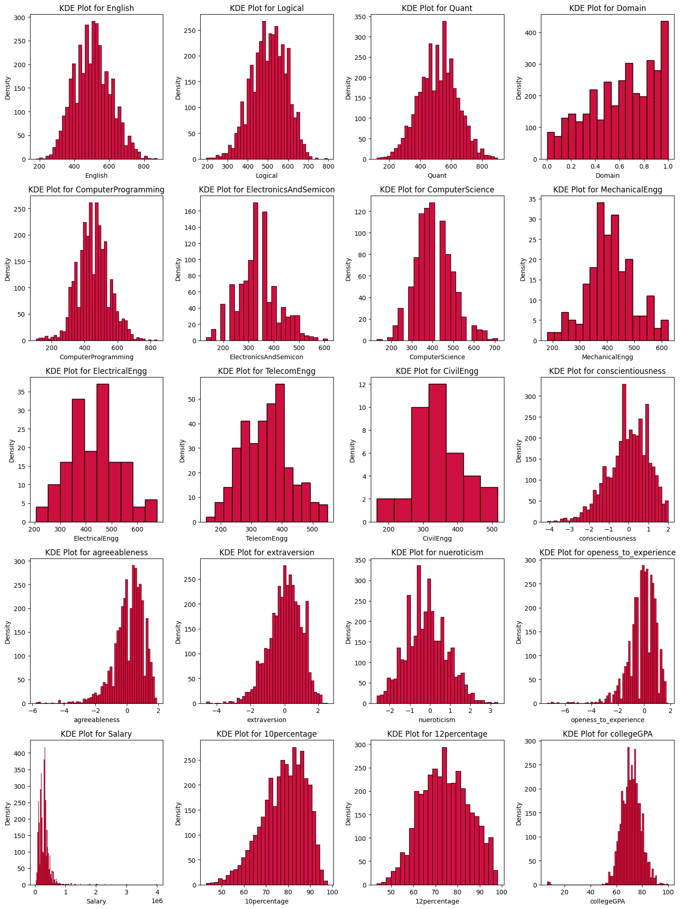
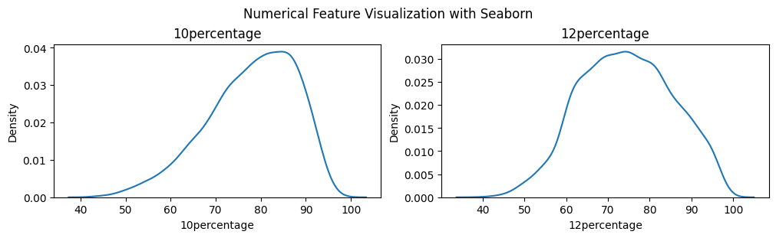
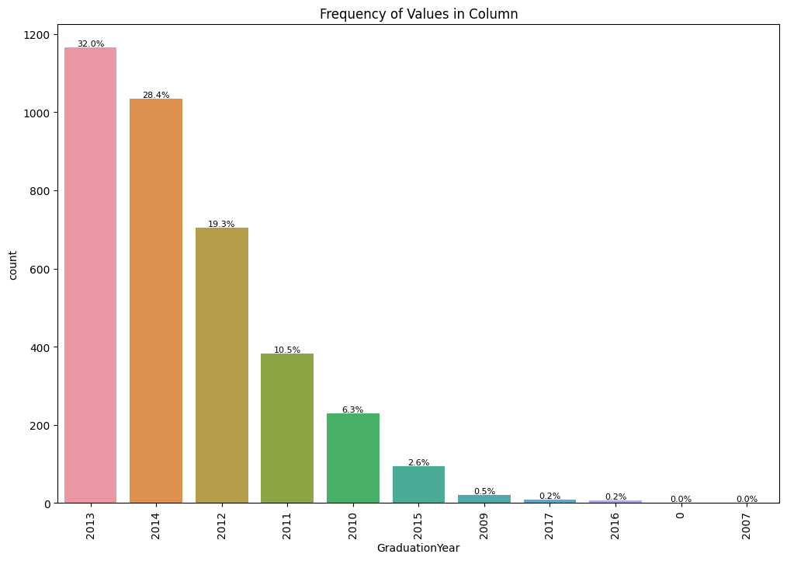
Univariate Analysis
The data indicates a typical range for college GPA lying between 60% to 80%, suggesting a distribution of academic performance among graduates within this range. In contrast, the percentages for 10th and 12th grades show a gradual increase from 60% to 90%, indicating a trend of academic improvement or higher achievement levels as students progress through secondary education. This upward trajectory in secondary school performance could reflect increased maturity, academic focus, or better preparation for college-level studies.

Slide 9
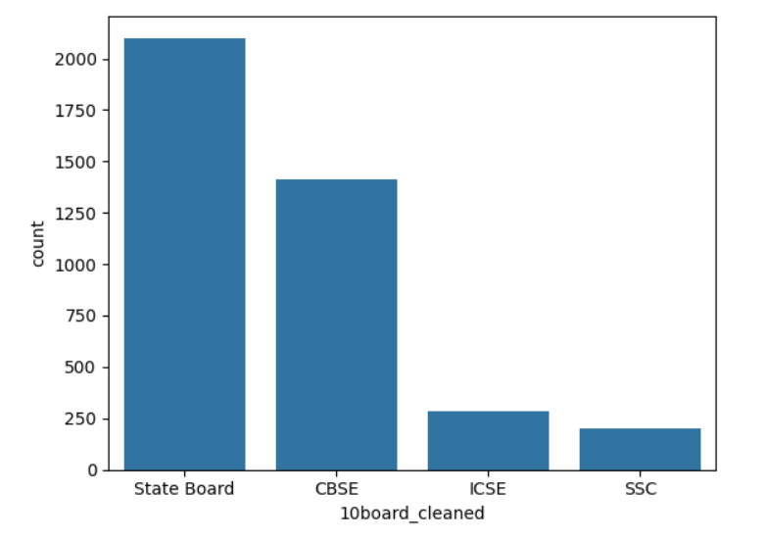
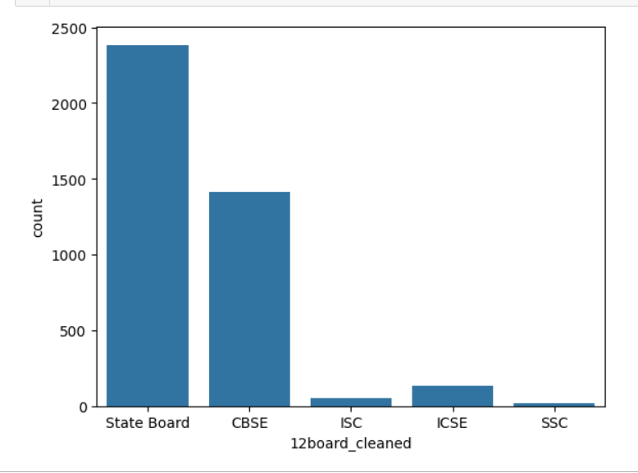
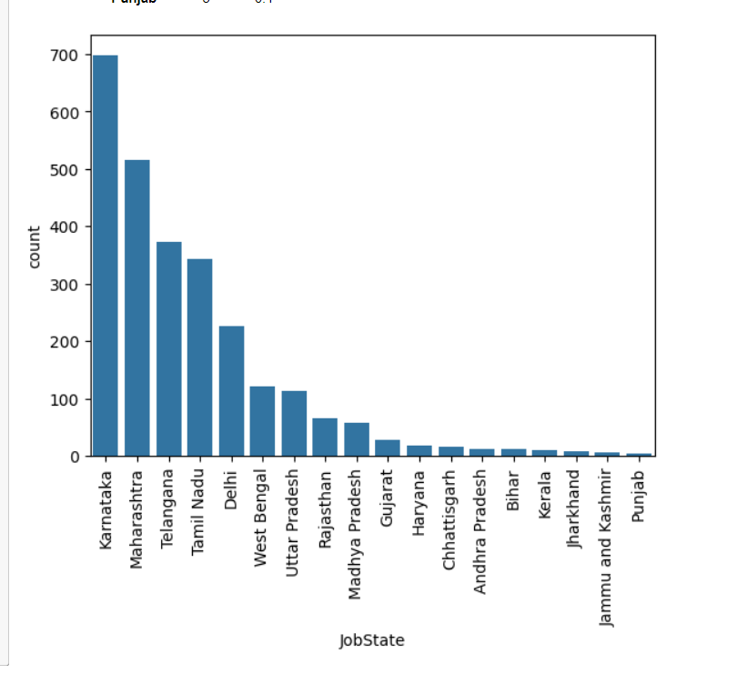
Job state and 10th and 12th Board
Concentration of grads in Bangalore, Noida, Hyderabad, Pune indicates urban job market appeal. Preference for state/CBSE boards suggests trust in quality, shaping educational paths. Tailored workforce strategies needed. Align policies with boards to foster excellence, readiness

Slide 10
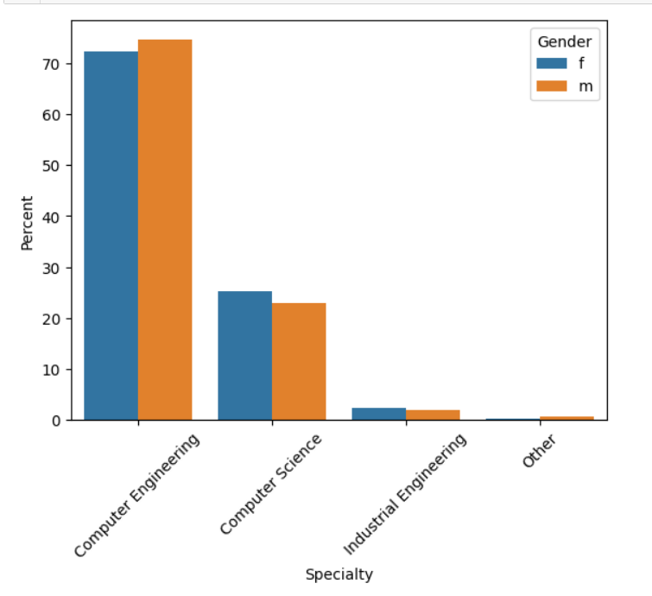
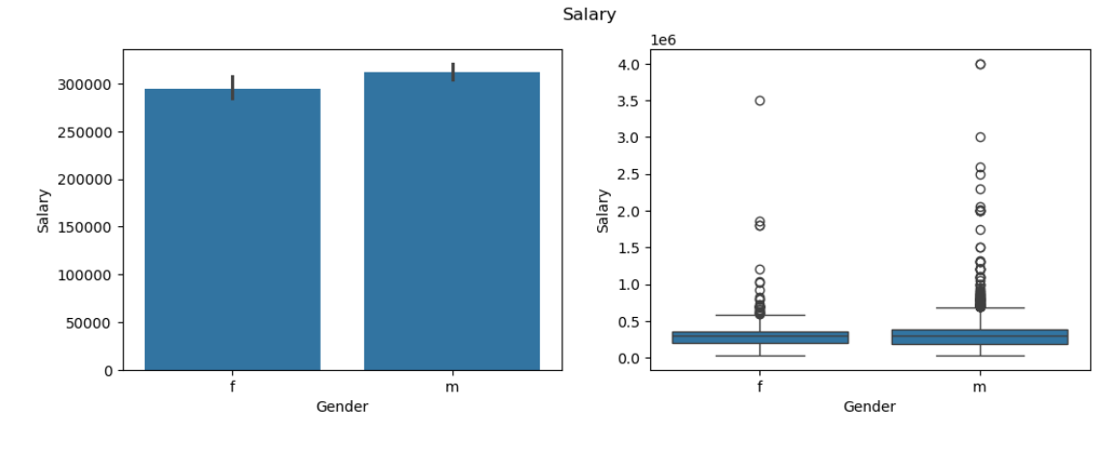
Bivariate Analysis
The data shows a slight variance in mean salary between genders, but determining significance requires further analysis, possibly involving statistical tests to ascertain if the difference is statistically meaningful or due to chance.
Male
v/s
Female
The data indicates a gender preference disparity in specialization choices among graduates: males lean towards computer engineering, while females show a preference for computer science as their field of study. This divergence highlights potential gender-based inclinations or societal influences in career paths within the technology sector.
Male
v/s
Female

Slide 11
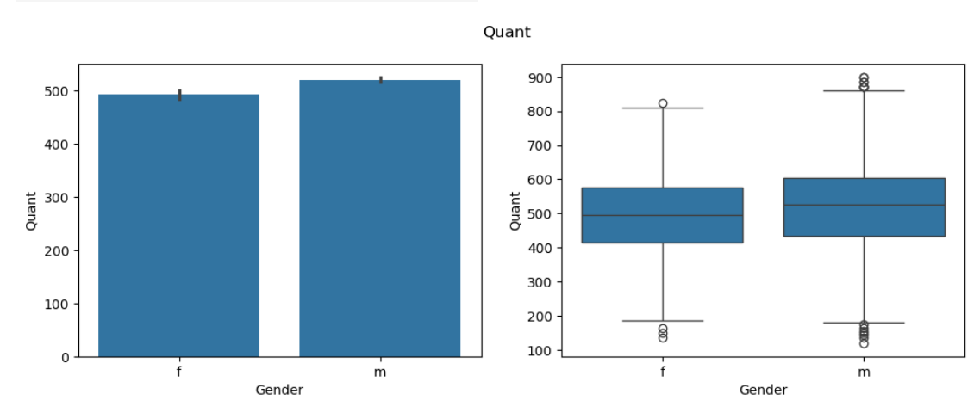
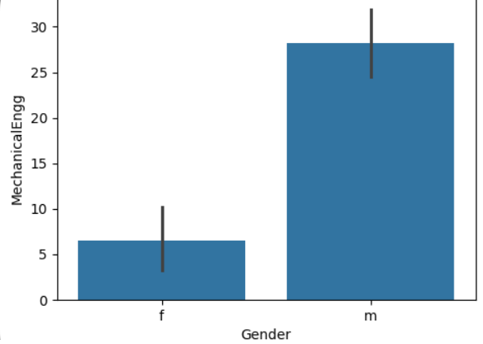
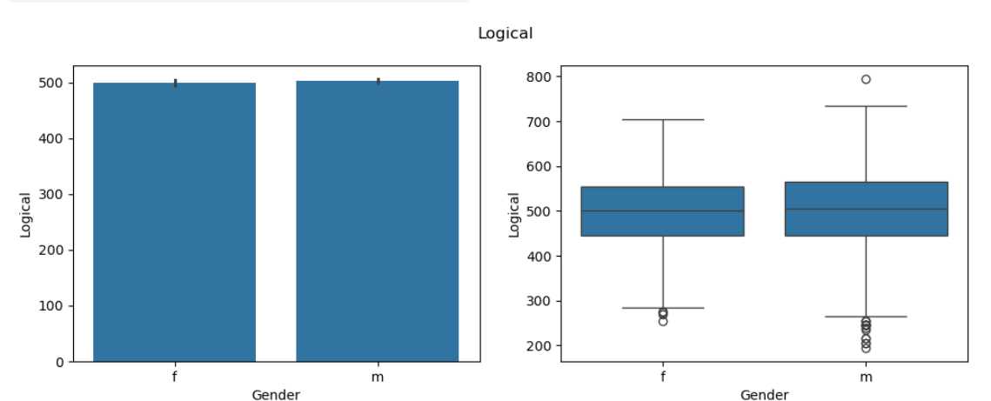
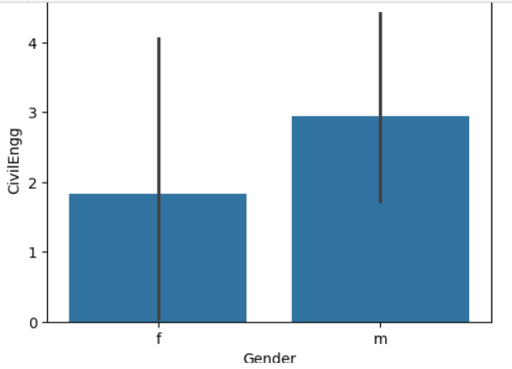
Gender v/s AMCAT scores
In terms of performance, graduates across logical reasoning, quantitative analysis, domain knowledge, computer programming, electronics and semiconductors, and computer science exhibit similar levels. However, male graduates excel comparatively in civil engineering, mechanical engineering, and electrical engineering disciplines. This suggests potential gender-specific strengths or preferences within these engineering fields.
AMCAT Board Scores

Slide 12
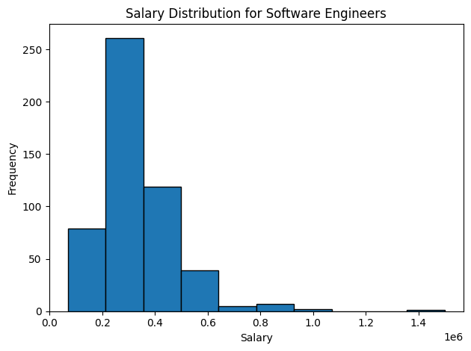
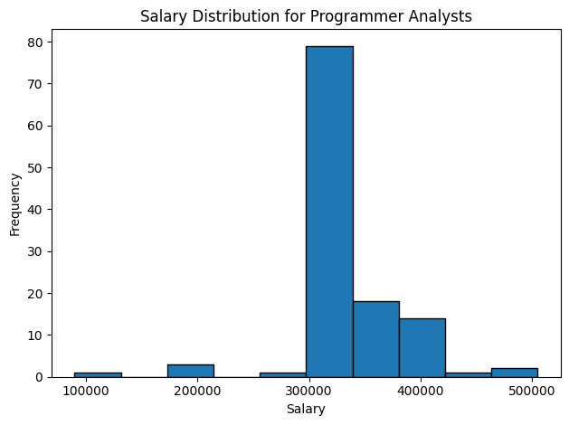
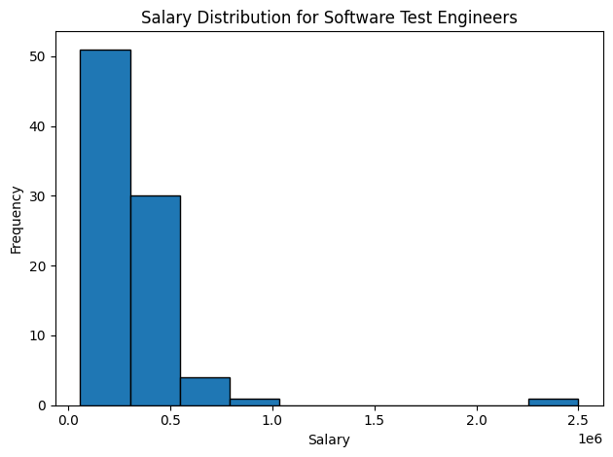
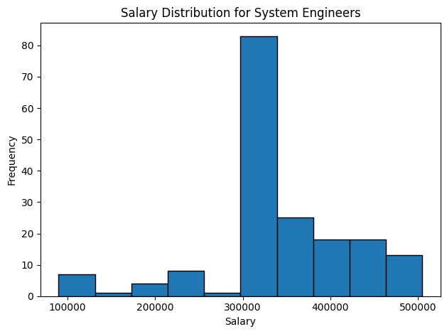
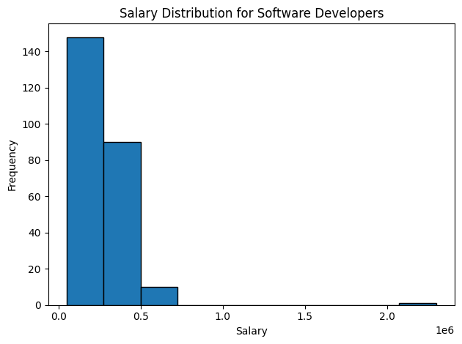
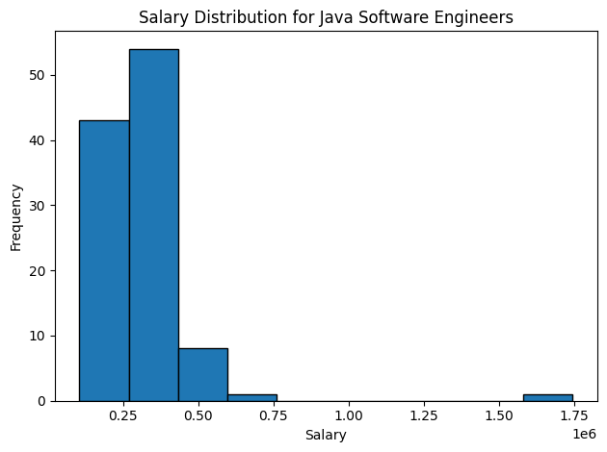
Job role vs salary
Software engineers, system engineers, and managers are notably earning higher salaries in comparison to other roes. This trend underscores the value placed on technical expertise and leadership within the industry, reflecting the demand for specialized skills and managerial acumen in driving organizational success and innovation.

Slide 13
Insights
There exists a robust correlation between 12th-grade performance and that of 10th grade, yet this association does not significantly impact one's collegiate GPA.
Proficiency in English often translates to proficiency in quantitative and logical domains, fostering comprehensive academic excellence.
Students characterized by agreeableness tend to exhibit a heightened receptiveness to new experiences, enhancing their overall academic and personal growth.
Mastery in English, logical reasoning, and quantitative skills invariably leads to superior performance in 10th-grade examinations.
Individuals possessing strong competencies in English, quantitative aptitude, and logical reasoning are poised to secure elevated salary packages and excel academically in both 10th and 12th grades.
The inherent openness of agreeable students primes them for seizing opportunities, potentially culminating in enhanced salary prospects compared to their counterparts.
Female students with advanced educational backgrounds often command higher starting salaries as freshers, outstripping their male counterparts in certain fields.
A commendable personality can serve as a compensatory factor for a lackluster college GPA, particularly in the realm of salary negotiations.
Despite the allure of higher starting salaries in disciplines like polymer technology and computer networking, enrollment rates in these courses remain relatively low.
Proficiency in English, logical reasoning, and quantitative skills not only fosters academic success but also serves as a springboard to lucrative career prospects, underscoring the multifaceted benefits of a well-rounded education.

Slide 14
Research Outcome
Project Objective: The primary goal is to analyze employee data to compare various percentage metrics, focusing on identifying outliers through boxplot analysis.
Comprehensive Analysis: Apart from salary, various other analyses are conducted, aiming to determine factors influencing compensation in the tech industry.
Outlier Identification: Boxplots are utilized to identify outliers within the dataset, allowing for the detection of unusual data points that may require further investigation.
City Concentration Analysis: Countplots are employed to identify cities with a higher concentration of employees, providing insights into regional workforce distribution.
Complex Salary Determinants: The analysis emphasizes the complexity of salary determinants in the tech industry, acknowledging that factors beyond job title or academic credentials play a significant role.
Need for Comprehensive Policies: The findings underscore the necessity for comprehensive compensation policies that consider various factors influencing salary, including location, experience, and skill set.
Talent Management Implications: Further research into the nuanced interplay of these factors could provide deeper insights into effective salary structuring and talent management practices in the tech sector, highlighting potential areas for improvement and optimization.

Slide 15

THANK YOU

